Slide 1
GRADUATION PROJECT · COURSE 307498
SolarWise Jordan
Is Solar Wise For Me?
Predicting rooftop solar generation anywhere in Jordan from weather alone — and turning it into an answer in dinars.
Shahed Farraj
Graduation Project · 2026
Notes:
Introduce yourself and the one question the project answers: if I put solar panels on my roof in Jordan, will I actually save money? Say the deck is in four parts — the problem, the data and the model, the dashboard, and the verdict. 20 seconds.

Slide 2
01 · INTRODUCTION
Why Solar, and What the Problem Is
A national opportunity, and a decision people currently make blind.
Why solar in Jordan
The problem
Jordan imports the large majority of its energy.
Sunlight is the one resource the country has in abundance.
Rooftop solar is growing fast — and it is expensive to get wrong.
People decide using a national average — or the seller’s number.
Generation changes across the country and across the year.
Nobody can tell a household what THEIR roof will produce.
The question this project answers: for this roof, in this month — how much will it generate, and is it worth the money?
SolarWise Jordan
2
Notes:
Two halves: why the topic matters nationally, and why the individual decision is currently blind. Land on the bottom line — that is the sentence the whole project exists to answer. 50 seconds.

Slide 3
01 · INTRODUCTION
Objectives
Four goals, each one tested later in this presentation.
1
Cover all of Jordan
2
Predict generation anywhere
Build a national grid of weather data — 131 locations, not a handful of cities.
From weather alone, at any coordinate a user can point to on a map.
3
Prove it works on new places
4
Turn it into a decision
Test on a year and a location the model never saw during training.
A verdict in dinars for a household, and a ranked map for an investor.
Objectives 2 and 3 are the ones this deck returns to with numbers.
SolarWise Jordan
3
Notes:
Read these once, do not dwell. Point out that objectives 2 and 3 come back later with hard numbers — that is the promise you are making to the examiners now. 35 seconds.

Slide 4
02 · THE SYSTEM
How the System Works
Four stages, from a satellite record to an answer on a screen.
1
Collect
2
Prepare
3
Learn
4
Deliver
NASA POWER daily API pulls 6 years of weather for 131 points across Jordan. Nominatim turns an address into coordinates and checks the point is inside the border.
Duplicates, hidden −999 codes and impossible readings removed. Dates converted, season encoded, target built.
Three models trained and compared. The winner is saved to disk with its feature list, ready to serve.
A Streamlit web app answers the household question. A Power BI dashboard ranks sites for investors.
▸
▸
▸
NASA POWER · Nominatim
pandas · NumPy
Linear regression - random forest – X-gboost
Streamlit · Folium · Plotly · Power BI
Two surfaces, one model. The household app and the investor dashboard read the same trained model and the same cleaned dataset — so they can never disagree.
SolarWise Jordan
4
Notes:
This is the map of the whole project — everything after this slide is a zoom into one of these four boxes. The line at the bottom is worth saying out loud: the app and the dashboard are two front doors to one model. 45 seconds.

Slide 5
03 · THE DATA
Where the Data Comes From
NASA POWER — satellite weather and solar data for any point on Earth.
285,699
131
Why we chose it
Records after cleaning
Locations across Jordan
Covers every coordinate in Jordan — not just a few weather stations.
Gives the same variables at prediction time as it did at training time.
Free, well documented, and needs no registration.
A regular grid, so no district is favoured just for having a weather station nearby.
6
7
Years · 2020 – 2025
Weather variables per day
Addresses are handled too. OpenStreetMap Nominatim converts a typed address into coordinates and confirms the point falls inside Jordan, at one request per second as its usage policy requires.
The seven variables
sunlight · clear-sky sunlight · cloud cover
temperature · humidity · wind · rainfall
SolarWise Jordan
5
Notes:
The strongest reason is the second one: the model sees exactly the same variables when it predicts as it did when it learned. There is no variable available in training that a user cannot supply later. 45 seconds.

Slide 6
03 · THE DATA
Cleaning the Data
Four steps, in order — and one of them is easy to miss.
1
Removed duplicates
2
Found hidden missing values
2,871 repeated records left behind by overlapping downloads.
NASA writes −999 instead of leaving a blank — 1,448 records. pandas reported no missing data, because −999 is a number.
3
Removed impossible readings
4
Prepared for the model
Temperatures of 150 °C and −80 °C. Only 5 records in total.
Converted dates, encoded the season, and built the prediction target.
290,023 → 285,699
1.49%
131 / 131
records kept
of rows removed
locations retained
SolarWise Jordan
6
Notes:
Step 2 is the one worth pausing on. pandas said there were no missing values, because minus nine nine nine looks like a perfectly valid number. Finding those was the difference between a clean model and a quietly broken one. 45 seconds.

Slide 7
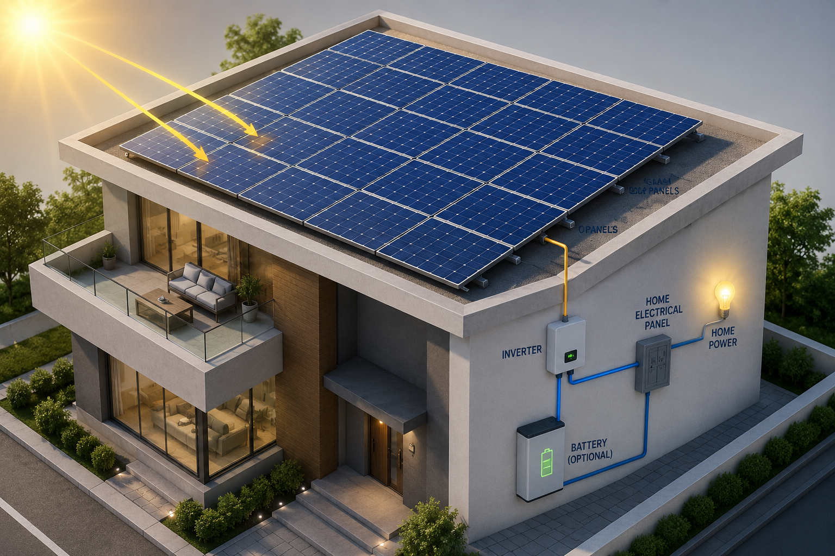
04 · THE MODEL
What the Model Predicts
Daily energy per kilowatt-peak of installed panels — kWh/kWp/day.
Energy = sunlight × performance ratio
the performance ratio falls as the panel heats up
Heat reduces output
A panel loses about 0.4% of its efficiency for every degree above 25 °C.
Panels run hotter than the air — 27.4 °C on average, against 19.7 °C ambient.
.
An outside check, not one of our own metrics confirming itself.
SolarWise Jordan
7
Notes:
Define the target clearly: kilowatt-hours per kilowatt-peak per day, so the answer does not depend on how big your system is. The sanity check matters because it is an external reference point — our number agrees with published figures for Jordan. 40 seconds.

Slide 8
05 · FINDINGS
Finding 1 — The Season Matters Most
Share of the variation in daily output explained by each factor.
What this means
WHEN you generate matters far more than WHERE in Jordan you are.
June: 6.17 kWh/kWp per day
December: 2.48
That is 2.5 times more in summer.
Location and year barely move the needle by comparison — together they account for under 2%.
So the answer we give a user must be monthly — a single yearly average would hide the months that actually decide whether solar pays.
SolarWise Jordan
9
Notes:
This one number — eighty-three percent — explains most of the design decisions that follow. It is why the app reports month by month rather than a single yearly figure. 45 seconds.

Slide 9
05 · FINDINGS
Finding 2 — Heat Hurts, and It Is Hidden
The raw correlation says one thing; a fair comparison says the opposite.
What the numbers seem to say
What actually happens
+0.69
−0.64
correlation between temperature and output
once days with the same sunlight are compared
Hotter days appear to produce more. But that is the season talking — hot days in Jordan are also sunny days.
Hold sunlight constant and hot days produce 5.2% less. The physics was there all along, hidden by the season.
Why the peak month is June, not July
July receives slightly more sunlight, but it is hotter — and the panels pay for it. The model reproduces this without being told.
SolarWise Jordan
10
Notes:
If an examiner says "your correlation shows heat helps, but you said heat hurts" — the answer is: compare days that receive the same sunlight and the sign reverses. June versus July is the physical proof. 45 seconds.

Slide 10
05 · FINDINGS
Finding 3 — Location Matters Less Than People Think
Annual yield across Jordan, in kWh per kWp per year.
1,737
1,532
13%
2.5×
Best — southern desert
Lowest — northern hills
Difference across Jordan
Difference across seasons
For a household
For an investor
Your location inside Jordan is not the deciding factor. What matters is how much electricity you use, and in which months you use it. System size and consumption dominate the result.
13% is worth having on a large project — but land price and grid access usually differ by more. The map ranks sites; it does not pick one — use it to shortlist, then decide on cost and grid connection.
Figures are per grid location. The dashboard aggregates to district level, which narrows the range to 1,557 – 1,733.
SolarWise Jordan
11
Notes:
The same number gives two different answers depending on who is asking. Note the small print: the deck quotes location-level extremes, the dashboard shows district averages, which is why the dashboard range looks narrower. 40 seconds.

Slide 11
06 · THE AI PART
We Compared Three Models
Same features, same split, same test set — only the algorithm changes.
Model RMSE | MAE | R²
Linear Regression 0.2273 | 0.152 | 0.971
Random Forest 0.1942 | 0.100 | 0.979
★ XGBoost 0.1781 | 0.097 | 0.982
Why not a simple line?
Heat helps on cloudy days and hurts on sunny days. A straight line cannot describe an effect that changes direction — trees can.
We did not choose XGBoost because it is popular. We chose it because the relationship is not a straight line.
XGBoost reduced the error by 36% compared with the linear model.
MAE is the average size of the mistake, in kWh/kWp/day. R² is the share of the variation the model reproduces — 1.0 would be perfect.
SolarWise Jordan
12
Notes:
Explain the two metrics briefly — the examiners will ask why there is no accuracy or F1 score, and the answer is that this is regression, not classification. 45 seconds.

Slide 12
06 · THE AI PART
How We Tested It
Two separate questions, answered with two separate held-out sets.
Can it predict a future year?
Can it predict a new place?
2020 – 2023
Training
One location was removed from the dataset completely — the model never saw a single record from it during training.
2024
Validation — choosing the model
0.9912
2025
Final test — used once, at the end
R²
2025 was opened only once, after every decision had already been made. That is what makes the final number honest.
SolarWise Jordan
13
Notes:
Stress the last line. Model selection happened on 2024; 2025 was untouched until the very end. If you tune on your test set, the test score means nothing. 45 seconds.

Slide 13
06 · THE AI PART
Performance Measurements
Results on the final test year, 2025.
0.9829
2.1%
0.9912
0.9892
R² — accuracy of fit
Average error
R² at a new location
R² at a new location, new year
No overfitting
Why these metrics?
An overfitted model scores well on the data it was tuned on and badly on anything new. Our validation and test scores are effectively identical — so the model learned the pattern, not the examples.
The answer is a number, not a category — so R² and mean error replace accuracy, precision and F1.
Validation year 2024: 0.9821 Test year 2025: 0.9829
SolarWise Jordan
14
Notes:
These are regression metrics, which is why there is no accuracy or F1 here. The two nearly-identical scores on the right of the green box are the real evidence against overfitting. 50 seconds.

Slide 14
06 · THE AI PART
Where the Model Is Weakest
Average error by month — winter is harder to predict than summer.
Why
Summer days are clear and steady, so the answer is almost certain.
Winter output depends on how thick the clouds are and when they pass — which a daily average cannot capture.
So winter answers are presented with a wider band of uncertainty.
Worst month, February: 0.192 kWh/kWp/day. Best month, July: 0.022.
SolarWise Jordan
15
Notes:
Saying where the model is weak is stronger than claiming it is perfect everywhere. It also sets up the limitation on the conclusion slide about showing a range rather than a single number. 35 seconds.

Slide 15
07 · THE APP
The App — From Question to Answer
One page for a household: three things in, one verdict out.
1
You give three things
2
The model answers
3
You get a decision
Location — type an address, tap the map, or use your phone’s GPS.
Electricity bill — your average monthly bill in JOD.
System size — the installed capacity in kWp.
NASA POWER supplies the weather for that exact coordinate.
XGBoost predicts how much the roof generates, month by month.
Monthly generation set against what the household actually uses.
The share of the year covered, and the saving in dinars.
A final verdict, in plain words.
▸
▸
Nothing technical is asked for
NASA POWER · XGBoost
Worth it · Partially · Not enough
Three ways to give a location. Type an address, tap a point on the map, or let the browser detect where you are. All three end in one coordinate, checked against Jordan’s border before anything is predicted.
SolarWise Jordan
16
Notes:
This is the household side of the project. Say the design rule out loud: the app never asks for anything a homeowner does not already know — an address, a bill, and a system size. Everything technical happens behind it. 45 seconds.

Slide 16
07 · THE APP
The App — What the Verdict Means
The same model, three households, three different answers.
Worth it
Partially worth it
Not enough
Aqaba
Irbid
Ajloun
Generation covers what the household uses across the year.
Generation helps and cuts the bill, but the cover is incomplete.
Generation is not sufficient for what this household uses.
What the result page shows: generation month by month · share of demand covered · saving in JOD · the final verdict.
The location is not what decides it — how much electricity the household uses, and how big the system is, decide the verdict.
SolarWise Jordan
17
Notes:
Three households, one model, three answers. Stress the last line: the verdict is driven by consumption and system size, not by which governorate the roof is in — that is Finding 3 again. Note that the app is willing to say “not enough”; that is what makes the other two verdicts trustworthy. 45 seconds.

Slide 17
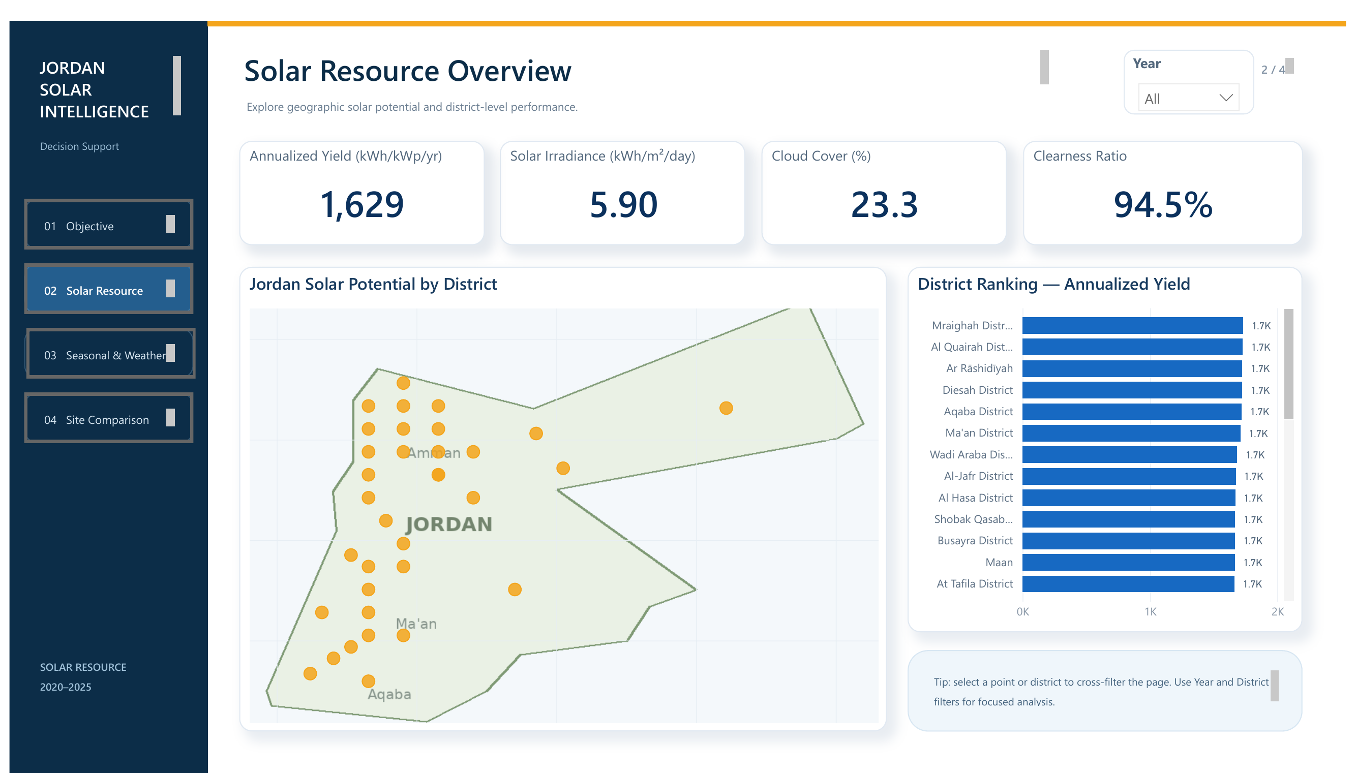
08 · THE DASHBOARD
Dashboard — Solar Resource
Power BI: geographic potential and district-level performance.
On this page
Map of all 131 locations across Jordan.
Districts ranked by annualised yield, 1,629 kWh/kWp/yr on average.
Cloud cover 23.3% and clearness ratio 94.5% nationally.
Year and district filters cross-filter the whole page.
ANSWERS
Where in Jordan is solar strongest?
SolarWise Jordan
18
Notes:
Demonstrate one filter live if you can — click a district on the map and show the ranking respond. That is the difference between a report and a static image. 45 seconds.

Slide 18
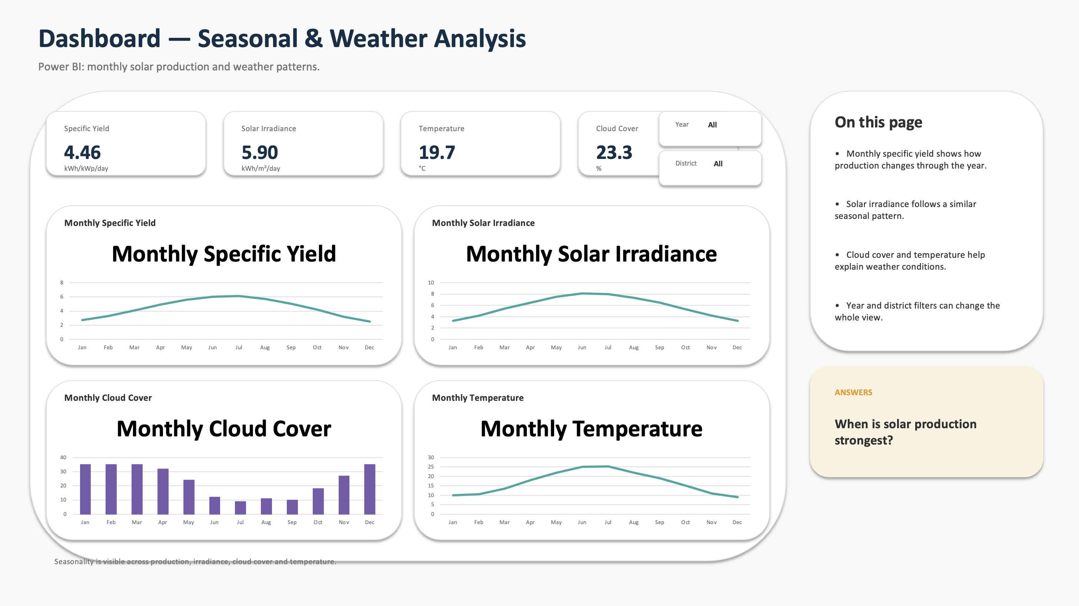

Slide 19
10 · CONCLUSION
Conclusion
What we built, what it cannot do yet, and where it goes next.
What we did
Limitations
Next steps
131 locations, 6 years of data
R² 0.9829 on an untouched test year
Works on places it never saw
A verdict in dinars, not a guess
Output is modelled, not measured from real panels
Nearby points share the same weather cell
Winter predictions are less certain
Selling surplus is not yet counted
Compare against real installed systems
Show a range, not a single number
Include income from selling surplus
Test on more unseen locations
Thank you — questions welcome.
SolarWise Jordan
21
Notes:
Close on the last line, pause, then invite questions. Do not rush past the limitations column — naming them yourself is what makes the rest credible. 45 seconds.

